Slide 1
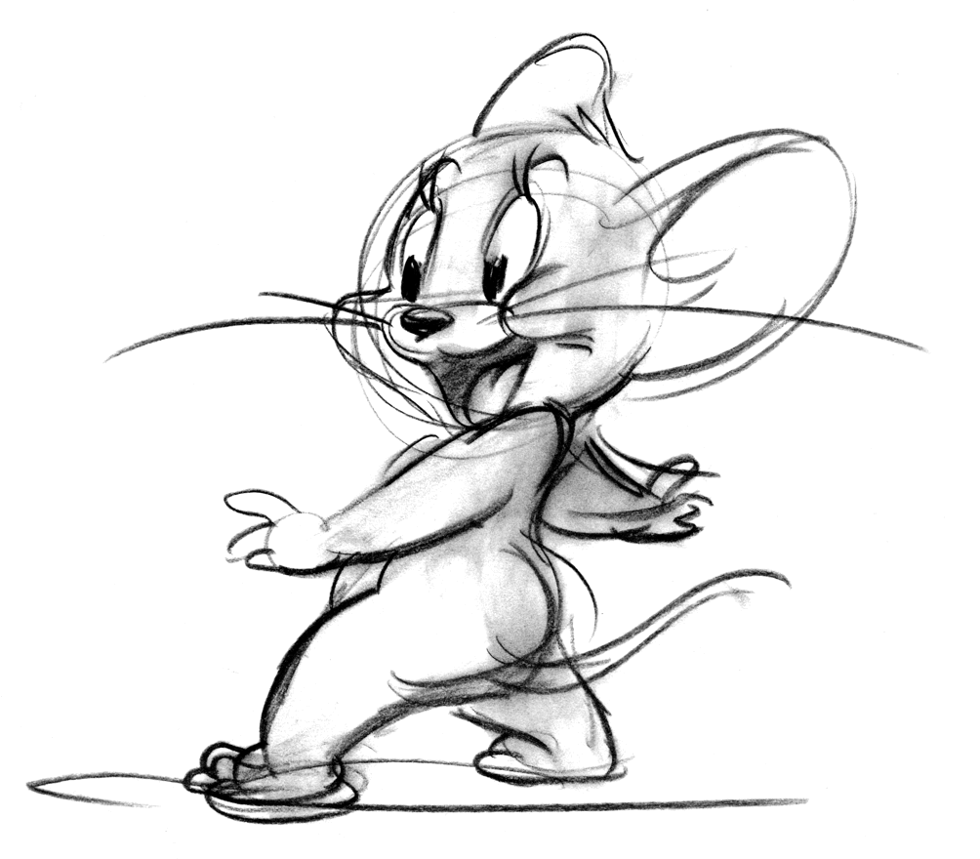
Mouse Tails

Slide 2
Frontend
Login/Logout & Register
Authentication/Authorization
Dark Mode

Slide 3
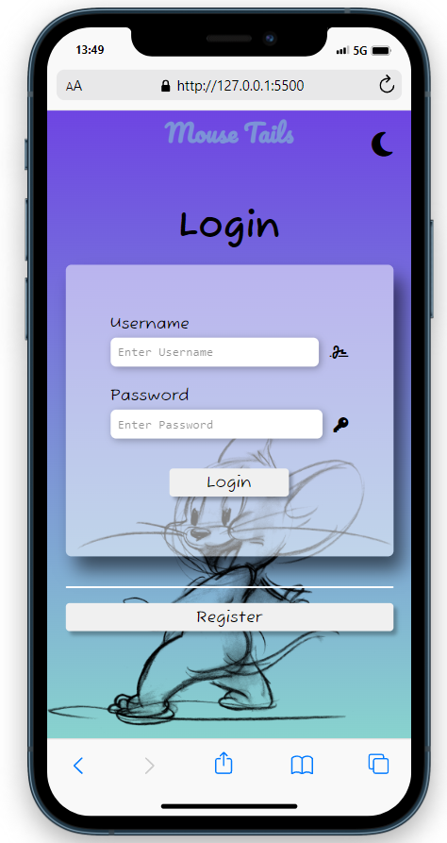
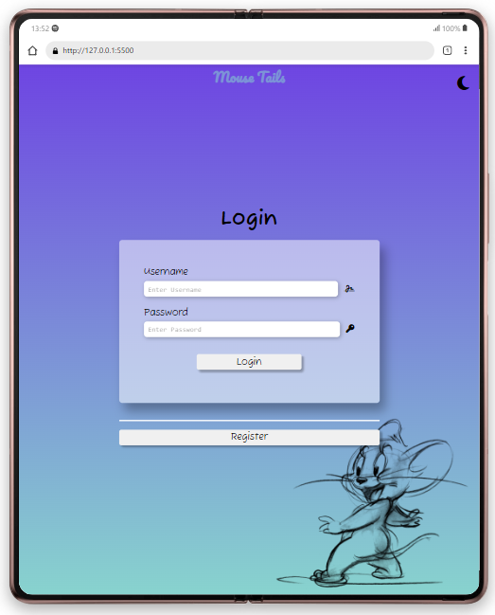
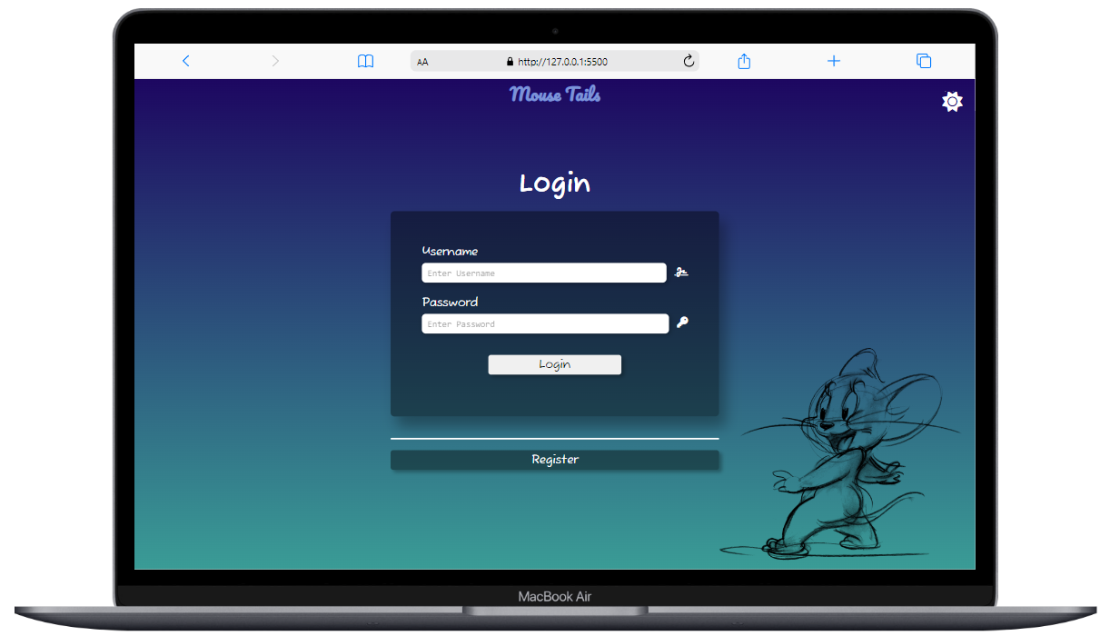

Slide 4
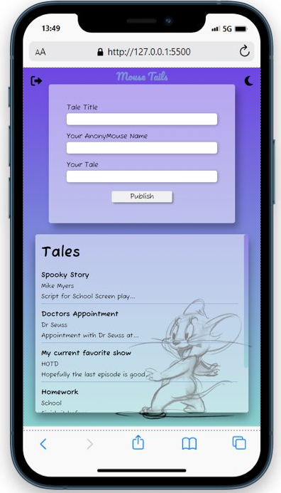
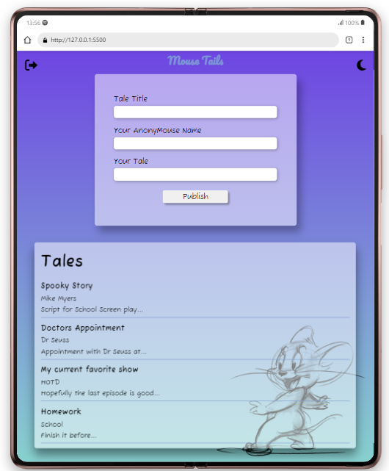
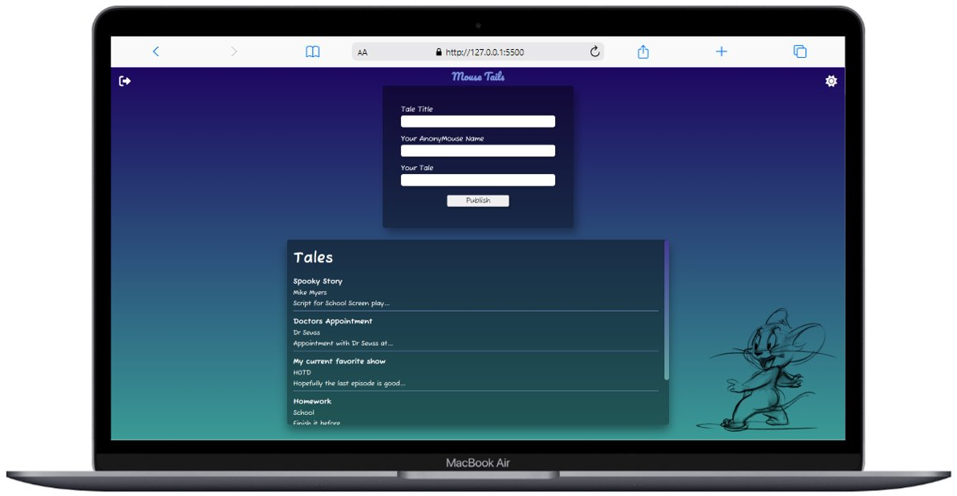

Slide 5
Backend
Users & Stories Data
NoSQL/MongoDB
Mongoose
Testing

Slide 6
Live Demo

